Slide 1
ER diagram
An Entity relationship diagram is a graphical representation of the entities, relationships and constraints that make up a given design

Slide 2
The parts of an ER diagram
ER Model Concepts
  Entities and Attributes
  Entity Types, Value Sets, and Key Attributes
  Relationships and Relationship Types
  Weak Entity Types
  Roles and Attributes in Relationship Types

Slide 3
Entities
Entities are specific objects or things in the mini-world that are represented in the database.
  A person, place, object, event or concept in the user environment about which the organization wishes to maintain data
  Represented by a rectangle in E-R diagrams
Real-world object distinguishable from other objects (e.g a student, car, job, subject, building ...)

Slide 4
Example of Entity
Entity
sname
Store
Locations
Relationship
manager
qty
Keeps
Attributes
pname
Product
price
descrip

Slide 5
Attributes
  Attributes are set of properties used to describe an entity. For example an EMPLOYEE entity may have a Name, ID, Address, Phone ,BirthDate
Attributes
Address
EMP ID
Name
Phone
Employee
Entity

Slide 6
Key Attributes: Identifier
Key (or uniqueness) constraints are applied to entity types
Key attribute’s values are distinct for each individual entity in the entity set
A key attribute has its name underlined inside the oval
Key must hold for every possible extension of the entity type
Multiple keys are possible
SSN
EMPLOYEE

Slide 7
Composite Vs. Simple Attributes
Composite attributes can be divided into smaller parts which represent simple attributes with independent meaning
Simple Attribute: Aircraft-Type
Complex Attribute: Aircraft-Location which is comprised of :
Aircraft-Latitude
Aircraft-Longitude
Aircraft-Altitude
Notation
… There is no formal concept of “composite
attribute” in the relational model

Slide 8
Derived Vs. Stored Attributes
Some attribute values can be derived from related attribute values:
Age ® Date - B-day
Y-Sal ® 12 * M-Sal
Notation
Age
M-sal
A stored attribute is a data value that is fixed and constant for an entity instance and is stored in a physical database. For example, a customer's name, age, and address are all stored attributes.
B-days
Y-sal
EMPLOYEE

Slide 9
Single Vs. Multivalued Attributes
Simple attributes can either be single-valued or multi-valued
SSN Number
Notation
Multivalued: Degree = {BSc, MInfTech}
Notation
An “attribute” in the relational model is always single valued – Values
are atomic!

Slide 10
SUMMARY OF ER-DIAGRAM
NOTATION FOR ER SCHEMAS
Symbol
Meaning
ENTITY TYPE
WEAK ENTITY TYPE
RELATIONSHIP TYPE
IDENTIFYING RELATIONSHIP TYPE
ATTRIBUTE
KEY ATTRIBUTE
MULTIVALUED ATTRIBUTE
COMPOSITE ATTRIBUTE
DERIVED ATTRIBUTE
TOTAL PARTICIPATION OF E₂ IN R
CARDINALITY RATIO 1:N FOR E₁:E₂ IN R
STRUCTURAL CONSTRAINT (min, max) ON PARTICIPATION OF E IN R
E₁
R
E₂
E₁
R
N
E₂
R
(min,max)
E

Slide 11
Identify the Attributes of the entities in our project
Student_ID
Phone
Address
DOB
Student
Name
Age

Slide 12
Faculty
Faculty_ID
Phone
Address
Email ID
Faculty
Name

Slide 13
Course
Venue
Course_ID
Slot
Course
Name

Slide 14
Relationship among Entities
  An association between the instances of one or more entity types that is of interest to the organization
  Association indicates that an event has occurred or that there is a natural link between entity types.
  Relationships are always labeled with verb phrases.
  A relationship relates two or more distinct entities with a specific meaning. For example, EMPLOYEE John Smith works on the ProductX PROJECT or EMPLOYEE Franklin Wong manages the Research DEPARTMENT.

Slide 15
Example
Employees
Supplier
Supply
Parts
Works_In
Departments

Slide 16
How to relate the entities of our project
Faculty_ID
Phone
Student_ID
Phone
Address
Address
DOB
Email ID
Student
Faculty
Name
Age
Name
Registers
Teaches
Course
Venue
Slot
Course_ID
Name

Slide 17
Relationship Degree
Departments
The degree of a relationship type is the number of participating entity types
– 2 entities: Binary Relationship
3 entities: Ternary Relationship
n entities: N-ary Relationship
Same entity type could participate in multiple relationship types
Works_In
Binary
Employees
Multiple
Supplier
Supply
Project
Assigned_to
Ternary
Part

Slide 18
Possible Cardinality Ratios
The “Cardinality Ratio” for a binary relationship specifies the number of relationship instances that an entity can participate in
– Works-In is a binary relationship
– Participating entities are
DEPARTMENT : EMPLOYEE
– One department can have
Many employees –
Cardinality Ratio is 1 : N
Departments
Works_In
Employees

Slide 19
Possible Cardinality Ratios
.
.
.
.
.
.
1–to-1 (1 : 1)
– Both entities can
participate in only one
relationship instance
1-to-Many, Many-to-1
(1 : N, N : 1)
– One entity can
participate in many
relationship instances
Many-to-Many (N: M)
– Both entities can participate in
many relationship instance
1-to-1
.
.
.
.
.
.
.
.
.
.
.
.
.
.
1- to - Many
Many - to - 1
.
.
.
.
.
.
.
Many-to-Many

Slide 20
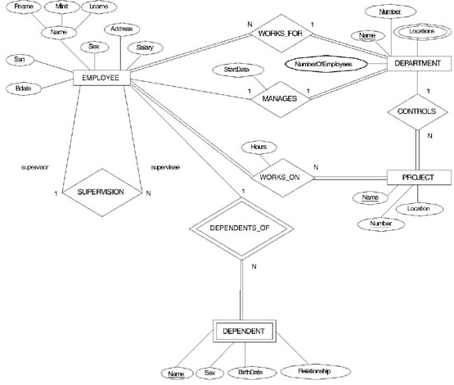

Slide 21
How to relate the entities
Faculty_ID
Phone
Student_ID
Phone
Address
Address
DOB
Email ID
Student
Faculty
Name
Age
Name
N
N
Registers
Teaches
M
M
Course
Venue
Slot
Course_ID
Name

